Slide 1
Social Studies Subject for High School: Globalization
Here is where your presentation begins

Slide 2
Contents of this template
You can delete this slide when you’re done editing the presentation
Fonts | To view this template correctly in PowerPoint, download and install the fonts we used
Used and alternative resources | An assortment of graphic resources that are suitable for use in this presentation
Thanks slide | You must keep it so that proper credits for our design are given
Colors | All the colors used in this presentation
Icons and infographic resources | These can be used in the template, and their size and color can be edited
Editable presentation theme | You can edit the master slides easily. For more info, click here
For more info:
SLIDESGO | BLOG | FAQS
You can visit our sister projects:
FREEPIK | FLATICON | STORYSET | WEPIK | VIDEVO

Slide 3
Table of contents
01
02
03
04
05
06
History
Ethnics
Globalization
You can describe the topic of the section here
You can describe the topic of the section here
You can describe the topic of the section here
Common problems
People
Conclusions
You can describe the topic of the section here
You can describe the topic of the section here
You can describe the topic of the section here

Slide 4
Whoa!
This can be the part of the presentation where you introduce yourself, write your email…

Slide 5
Introduction
You can give a brief description of the topic you want to talk about here. For example, if you want to talk about Mercury, you can say that it’s the smallest planet in the entire Solar System

Slide 6
01
History
You can enter a subtitle here if you need it

Slide 7
Things that changed history
Internet
Airplanes
Mercury is the closest planet to the Sun and the smallest one in the entire Solar System. This planet's name has nothing to do with the liquid metal, since Mercury was named after the Roman messenger god
Despite being closer to the Sun than Venus, its temperatures aren't as terribly hot as that planet's. Its surface is quite similar to that of Earth's Moon, which means there are a lot of craters and plains

Slide 8
General characteristics
Do you know what helps you make your point clear?
Lists like this one:
They’re simple
You can organize your ideas clearly
You’ll never forget to buy milk!
And the most important thing: the audience won’t miss the point of your presentation

Slide 9
Cultural differences
In Europe
Neptune is the fourth-largest object by diameter in the Solar System
In America
Saturn is a gas giant and has several rings. It's composed of hydrogen

Slide 10
The first movement
African people
Merchants
Migration
Neptune is the farthest planet from the Sun
The Sun is the star at the center of all
The Moon is Earth’s only natural satellite

Slide 11
When did globalization start?
Columbus’ voyages
Political activities
Venus has a nice name and it’s the second planet from the Sun
Earth is the only one that harbors life in the Solar System
New World
Cultural activities
Despite being red, Mars is actually a cold place
Jupiter is a gas giant and the biggest planet in the System

Slide 12
History vs interpretations
 | Historical trends | Ideological interpretations
Economic dimension | Mercury is the closest planet to the Sun and the smallest one ever | Venus has a beautiful name and it’s the second planet to the Sun
Political dimension | Earth is the third planet from the Sun and our home | Despite being red, Mars is actually a cold place
Cultural dimension | Jupiter is a gas giant and the biggest planet in the System | Saturn is a gas giant and has several rings

Slide 13
Historical examples
The Americas
Indian trading
Triangle trade
Mercury is the smallest planet of them all
Venus has a beautiful name and high temperatures
Earth is the only planet known to harbor life
The silk road
Ocean trading
Despite being red, Mars is actually a cold place
Jupiter is the biggest planet in the Solar System

Slide 14
Why was globalization created?
Reason #1
Reason #2
Reason #3
Mercury is the smallest planet of them all
Venus has a beautiful name and high temperatures
Earth is the only planet known to harbor life
Reason #4
Reason #5
Reason #6
Despite being red, Mars is actually a cold place
Jupiter is the biggest planet in the Solar System
Saturn is not the only planet with rings

Slide 15
—Someone Famous
“This is a quote, words full of wisdom that someone important said and can make the reader get inspired.”

Slide 16
74%
45,129
23,587
+52.6
Mercury is a small planet
Venus is a hot planet
Earth is the planet with life
Mars was named after a god

Slide 17
Understanding the statistics
16%
84%
Rest of the world
Jupiter is a gas giant and the biggest planet in the Solar System
Globalized countries
Venus is the second-largest planet in the Solar System

Slide 18
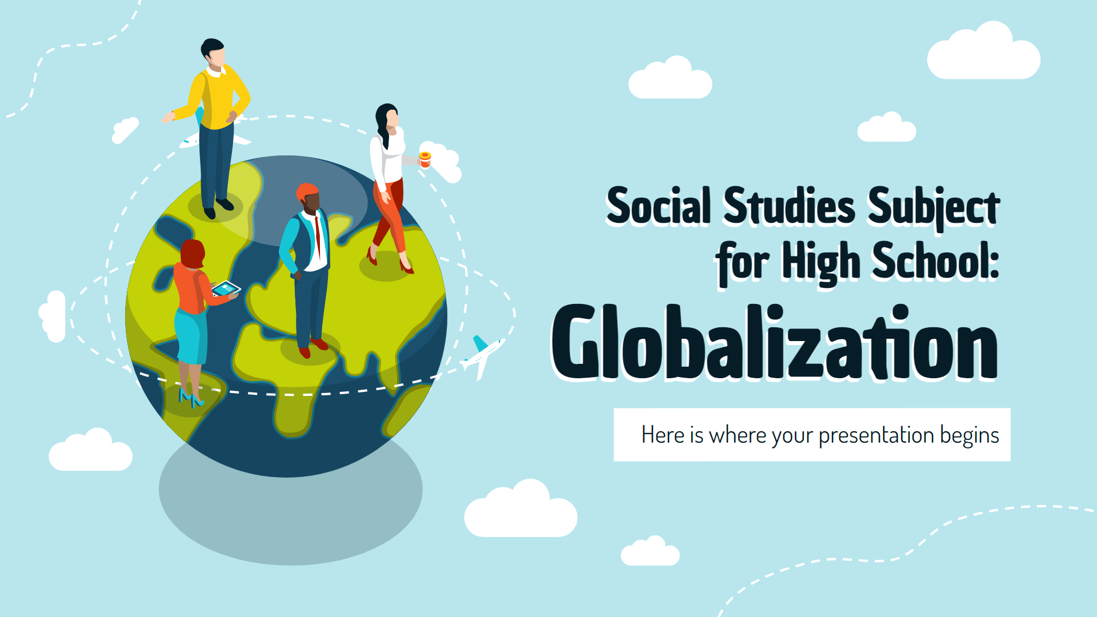
Desktop mockup
You can replace the image on the screen with your own work. Just right-click on it and select “Replace image”

Slide 19

Tablet mockup
You can replace the image on the screen with your own work. Just right-click on it and select “Replace image”

Slide 20
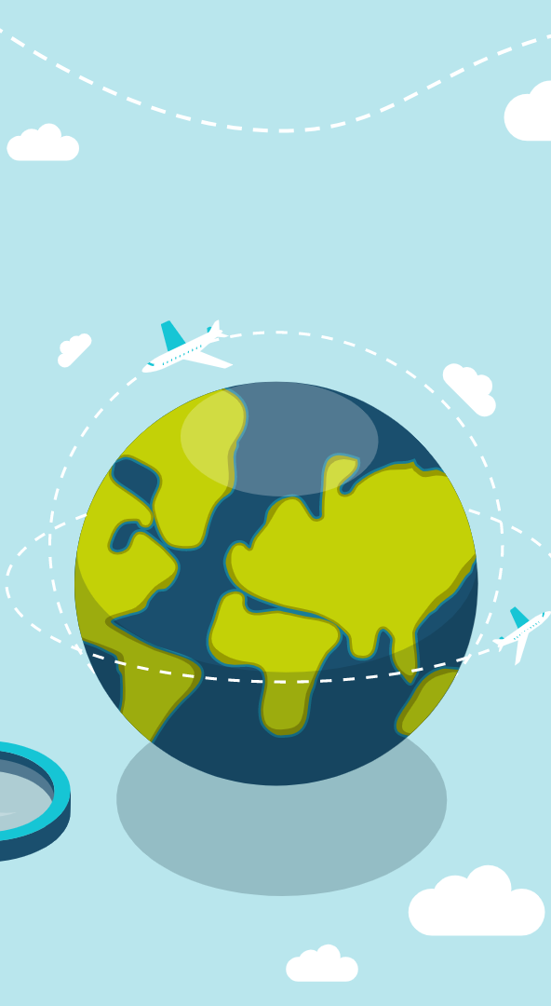
Cell phone mockup
You can replace the image on the screen with your own work. Just right-click on it and select “Replace image”

Slide 21
03
Globalization
You can enter a subtitle here if you need it

Slide 22
Most influential countries
China
The Sun is the star at the center of all
Russia
The Moon is Earth’s only natural satellite
United States
Pluto is now seen as a dwarf planet

Slide 23
Timeline
Mars
Jupiter
Saturn
Neptune
Despite being red, Mars is very cold
Jupiter doesn’t have a solid surface
Saturn was named after a Roman god
Neptune is very far away from the Sun

Slide 24
Globalization explained
Characteristic A
Characteristic C
The Sun is the star at the center of the Solar System
Ceres is located in the main asteroid belt
Characteristic B
Characteristic D
Pluto is now considered a dwarf planet
The Moon is Earth’s only natural satellite

Slide 25

How globalization affects people?
43%
Men
Men
Mercury is the closest planet to the Sun
Women
22%
Women
Other
Venus is the second planet from the Sun
0
25
50
75
100
35%
Other
Follow the link in the graph to modify its data and then paste the new one here. For more info, click here
Earth is the only planet that harbors life

Slide 26
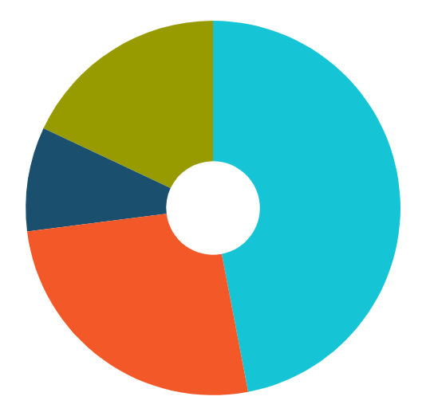
Region’s revolution
Jupiter
18%
47%
Mercury
Jupiter is the biggest planet in the System
Mercury is the closest planet to the Sun
Earth
09%
26%
Venus
Earth is the third planet from the Sun
Venus has extremely high temperatures
Follow the link in the graph to modify its data and then paste the new one here. For more info, click here

Slide 27




Our team
Simon Luhr
Benjamin Sikes
Ana Alvarado
Regina Schell
You can speak a bit about this person here
You can speak a bit about this person here
You can speak a bit about this person here
You can speak a bit about this person here

Slide 28
First globalized countries
Country #1
Country #2
Saturn is a gas giant and has several rings
Neptune is the farthest planet from the Sun
Country #3
The Sun is the star at the center of the Solar System

Slide 29
You can write conclusions!
Conclusion 1:
Write a conclusion about globalization and how to talk about it as a social studies subject in here
Conclusion 2:
Write a conclusion about globalization and how to talk about it as a social studies subject in here
Conclusion 3:
Write a conclusion about globalization and how to talk about it as a social studies subject in here

Slide 30
Thanks!
Does anyone have any questions?
addyouremail@freepik.com
+91 620 421 838
yourcompany.com
Please keep this slide as attribution

